Slide 1

Marketing Data and Technology
Draw Insights from Marketing Data

Slide 2

Part One:
Setting Goals

Slide 3
Identify Key Business Objectives
Key Business Objective: A defined goal or outcome used to plan the desired direction of your company. Write at least 3 but no more than 5 business objectives that support your business model. Each objective should be SMART.
1 | Work with at least 10 influencers during the next three months to help more people know about our products and visit our online store.
2 | Increase the online stores ‘s conversion rate from 2% to 3% by improving the checkout process in three months.
3 | Partner with at least 5 organizations within the next 6 months to sell google branded notebooks and pens in bulk expanding brand presence through B2B sales.
4 | SMART Key Business Objective 4 (optional)
5 | SMART Key Business Objective 5 (optional)

Slide 4
Identify Key Performance Indicators
Key Performance Indicator (KPI): A quantifiable metric used to determine how effectively your key business objectives are being met. Ensure that the specific metric is clearly identified.
1 | Increase the total number of orders by 15% within 3 months through influencer marketing campaigns.
2 | Increase the number of completed checkouts by 20% within 3 months by improving the checkout experience.
3 | Achieve at least 5 signed contracts with organization within 6 months to supply bulk google branded stationery.
4 | Key Performance Indicator 4 for Key Business Objective 4 (optional)
5 | Key Performance Indicator 5 for Key Business Objective 5 (optional)

Slide 5
Part Two:
A/B Testing Proposal

Slide 6
A/B Testing Proposal: KPI, Variable, and Hypothesis
KPI used as basis for the A/B test
Conversion rate
Variable that will have an impact on the KPI
Adding a visible “14-day, return guarantee “ message near the checkout button.
Hypothesis for your A/B Test
If we had a clear message about 14-day, return guarantee near the checkout button, users will feel more confident and more of them will complete the purchase, increasing the conversion rate. A/B Test Design: ﻿﻿Group A (Control): Current checkout page without any return guarantee message. ﻿﻿Group B (Variant): Checkout page with a visible“ 14 days return guarantee" message near the payment entry field.

Slide 7
A/B Testing Proposal: Details and results
Details of the A/B test
Variations being tested: | Group A (Control): Current checkout page without any return guarantee message.
 | Group B (Variant): Checkout page with a visible“ 14 days return guarantee" message near the payment entry field.
User groups: | Users will be randomly split into two equal groups. Group A will see the checkout page without the guarantee message, and Group B will see the checkout page with the message.
Data collection tool: | Google Analytics and Google Optimize
Length of the test: | 4 weeks
Describe how you would determine the results of the A/B test
We will compare the conversion rate between Group A and Group B. If Group B has a higher conversion rate, the guarantee message will be considered effective. A higher rate means more users completed their purchase.

Slide 8
Part Three:
Data Exploration

Slide 9
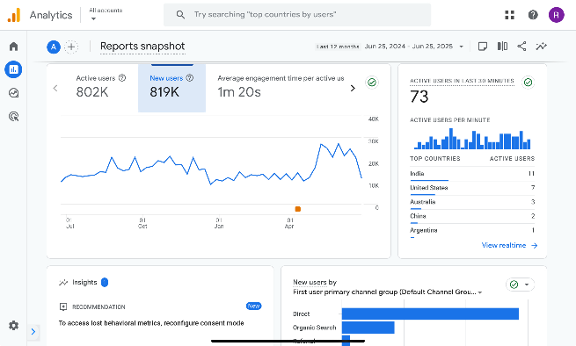
Reports Snapshot
From the Reports Snapshot, select a twelve month time period you would like to explore.
Ensure that the following are visible in the screenshot:
Timeframe
New users
Axis values

Slide 10
Reports Snapshot
Which month had the most new users?
April 2025 had the most new users.
Which month had the fewest new users?
February 2025 had the fewest new users.
Write some ideas why certain trends are associated with these specific months?
April might have had promotions, new product launches, or seasonal marketing campaigns. February could be slower due to fewer marketing efforts or post-holiday shopping fatigue.

Slide 11
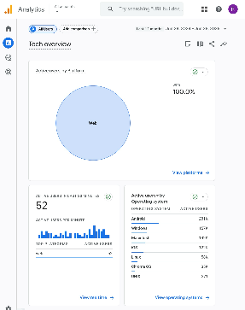
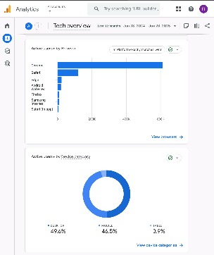
User Tech
Please go into the User → Tech → Tech overview report for the following:
For the twelve month period you’ve chosen, provide a screenshot showing percentage chart (donut charts) of All Users that came from mobile, desktop, and tablet devices.
Ensure that the following are visible in the screenshot:
Device Category
Donut chart showing % breakdown by device
Note that the time frame selected does not need to be visible in the screenshot..

Slide 12
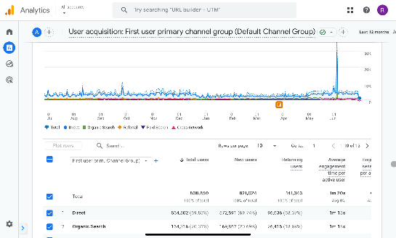
User Acquisition
For this section, if you are using your own business’s Google Analytics data but do not have eCommerce capabilities established, please use the Google Analytics demo data provided from the Google Merchandise store.
Take a screenshot that shows the Engagement rate of the different acquisition channels over a 12 month period.
Ensure that the following are visible in the screenshot:
Channel group
Users
Engagement Rate
Note that the time frame selected does not need to be visible in the screenshot, but will be reflected by the number of users.

Slide 13
User Acquisition
Which channel groups had the highest and lowest engagement rates?
Highest: Organic Shopping (80.36%)
Lowest: Unassigned (9.41%)
Which channel groups had the highest and lowest total revenue?
Highest: Direct ($1,293,354.86)
Lowest: Paid Other ($0.00)
What do these metrics mean, based on your experience?
These metrics show that not all traffic works the same.
Direct traffic brings the most revenue, likely because users already know and trust the brand.
Organic Shopping has the highest engagement rate but low sales — maybe users are just browsing.
This means some channels bring attention, and others bring sales. Both are important for business success.

Slide 14
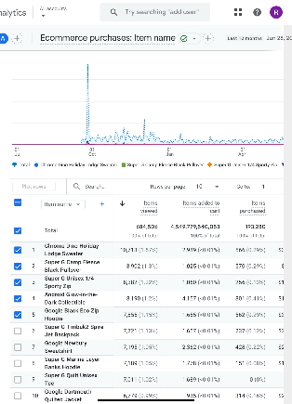
Monetization
For this section, if you are using your own business’s Google Analytics data but do not have eCommerce capabilities established, please use the Google Analytics demo data provided from the Google Merchandise store.
During the twelve month period you’ve selected, provide a screenshot that shows the Item name that contributed the highest number of unique purchases and the item name that was responsible for the largest percentage of revenue? (Screenshot(s) only; no annotation required.)
Ensure that the following are visible in the screenshot:
Item names
Number of items purchased
Item revenue

Slide 15
Part Four:
Segmentation

Slide 16
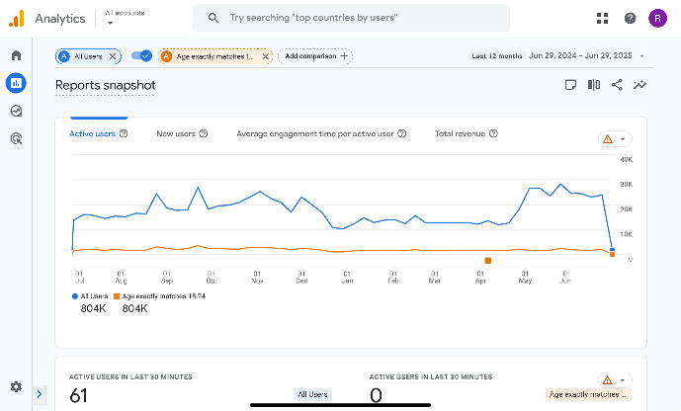
Audience Segment: Demographics
Place the screenshot here, that includes a comparison of your chosen Audience Demographic segment and “All Users”
Values used: | Audience segment: Age exactly matches 18-24 Compared to: All Users

Slide 17
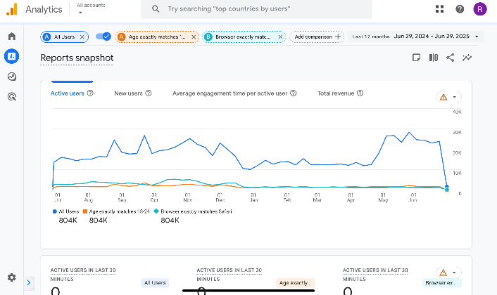
Audience Segment: Technology
Place the screenshot here, that includes a comparison of your chosen Audience Demographic segment and “All Users”
Values used: | Technology segment: Browser exactly matches Safari Compared to: All Users

Slide 18
Part Five:
Analysis and Suggestions

Slide 19
Google Merchandise Store data
You can find the results of the Google Merchandise Store campaigns below.
Campaign Name | Cost | Revenue | ROAS
Tech Trends: Discover the Latest Google Gear | $5,000 | $3,000 | 0.6
Shop with Google: Unleash Your Digital Lifestyle | $5,000 | $8,000 | 1.6
Google Gadgets Galore: Elevate Your Tech Game | $5,000 | $8,000 | 1.6
Gear Up with Google: Your One-Stop Tech Shop | $8,000 | $13,000 | 1.625
Google Merch Madness: Score Big on Tech Essentials | $5,000 | $2,000 | 0.4
Unlock the Power of Google: Shop the Best in Tech | $2,000 | $3,500 | 1.75
Totals | $30,000 | $37,500

Slide 20
Business Sales Growth
Based on the data provided, how might the campaigns be realigned and improved to potentially achieve a 20% YOY sales growth without additional cost? You can assume that the data will remain consistent over the projected time frame. Please reference specific data to support your answer, such as metrics and campaigns.
You could get the answer by asking yourself: Which campaign would I spend less, and which would I spend more?
To improve sales without extra cost, we can focus on Organic Search because users had high engagement. We can improve visibility by writing blog posts and using better keywords.
The Android Collectible was a top-selling item, so we can promote it more on the homepage.
Also, Direct traffic brought the highest revenue, so we can send email offers or discounts to bring those users back.

Slide 21
eCommerce improvements
Looking at your website pages or the Google Merchandise Store website and current eCommerce experience, identify one change to the eCommerce UX and one additional eCommerce option you would recommend implementing.
Example: One way to improve eCommerce capabilities would be to add the option of a digital wallet with the option to securely store and manage cards that have been used for payment, along with the option of using PayPal or Apple Pay.
UX change:
Add a progress bar in the checkout process to help users see how many steps are left. This can reduce confusion and increase completed purchases.
Other eCommerce change or addition:
Allow customers to check out as a guest without needing to create an account. This makes the process faster and encourages more sales.

Slide 22
Technology
It is time for some exploration! You need to find 2 emerging marketing technologies that you could use in a technology stack. For each one, you need to describe why you would use that tool.
1 | Chatbots powered by AI (e.g., ChatGPT or Drift)
 | To provide real-time support and answer customer questions automatically, improving user experience and saving time for support teams.
2 | Customer Data Platforms (CDPs)
 | To collect and unify customer data from different sources, helping marketers deliver more personalized and targeted campaigns.

